Slide 1
HOSPITALITY Of FINANCE
Data Analyst Project
DA_P184| Group 3| Mentor: Mahindra Singh

Slide 2


Slide 3

“Hospitality is the art of making others feel welcome, comfortable, and at home. Finance is the foundation that enables this art to flourish.“

Slide 4







MEET OUR TEAM
Mrs. Venkata Lakshmi Anusha Macherla
Mr. Kanchu Sai Charan
Mr.
Naveen M C
Mr. Nikesh Narayan Gathadi
Mr. Dasharth Bhavarlal Khatri
Mr. Shreyash
Arjun Naikwadi
Mr. Sabarish
K P

Slide 5
INTRODUCTION
The hospitality industry is a large and complex sector, with businesses of all sizes operating in a variety of settings. As a result, financial management is essential for the success of any hospitality operation.
Through our collaborative efforts and data analysis, we have successfully created an Excel, Tableau, Power BI Dashboards that provides valuable insights into the hospitality industry. The purpose of this project was to analyze hospitality data and enable decision-making and strategy formulation.
This presentation will provide an overview of the key financial concepts and tools that are used in the hospitality industry. We will discuss topics such as:

Slide 6
CONTENTS
Key Metrics:
Total Departmental Expenses
Total FF&E Reserves
Total Management Fees
Total Non Operating Expenses
Total Revenue
Total Rooms Available
Total Rooms Revenue
Total Rooms Sold
Total Undistributed Expenses
ADR (Average Daily Rate) : [Total Rooms Revenue] / [Total Rooms Sold]
EBITDA : [Gross Operating Profit] - [Management Fees and NonOperating Expenses]
EBITDA % : [EBITDA] / [Total Revenue]
Gross Operating Income : [Total Revenue] - [Total Departmental Expenses]
Gross Operating Income % : [Gross Operating Income] / [Total Revenue]
Gross Operating Profit : [Gross Operating Income] - [Total Undistributed Expenses]
Gross Operating Profit % : [Gross Operating Profit] / [Total Revenue]
Management Fees and Non-Operating Expenses : [Total Management Fees] + [Total Non-Operating Expenses
Net Operating Income : [EBITDA] - [Total FF&E Reserves]
Net Operating Income % : [Net Operating Income] / [Total Revenue]
OCC (Occupancy Rate) : [Total Rooms Sold] / [Total Rooms Available]
RevPAR (Revenue per Available Room) : [Total Rooms Revenue] / [Total Rooms Available]

Slide 7
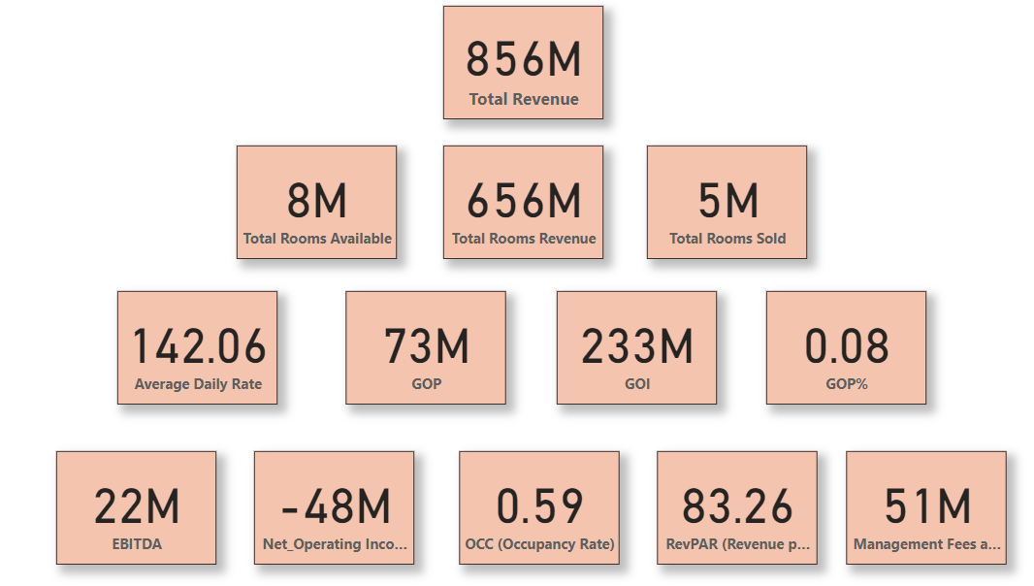
HOSPITALITY KPI CARDS

Slide 8
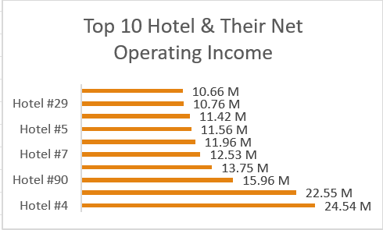
The hotels in the chart have a wide range of NOI, from $10.66 million to $24.54 million.
The hotel with the highest NOI (Hotel #4) has a very high ADR of $22.55 million. This suggests that the hotel is in a desirable area and that it can charge a premium for its rooms.
The hotel with the lowest NOI (Hotel #29) has a very low ADR of $10.66 million. This suggests that the hotel is in a less desirable area and that it is not able to charge a premium for its rooms
INSIGHTS:
In these top 10 hotels in the chart are all located in the United States and hotel industry is very competitive in US, and that only the best hotels can achieve high NOIs.
Long-term planning that aligns with market trends and customer demands is essential for sustained growth and profitability.
The ADR-NOI relationship is a critical aspect of hospitality finance. Identifying the factors influencing ADR and making informed decisions to optimize NOI can lead to increased financial success and better positioning in the competitive market.

Slide 9
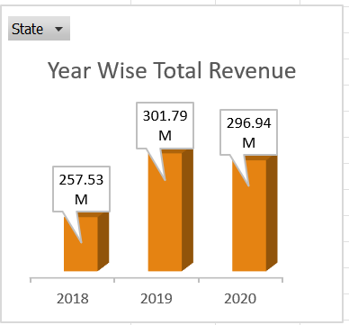
Here we have used bar chart for showing the Year wise Total Revenue and we can check state wise total revenue year on year by using filter. In this chart 2019 year has highest revenue with 302M comparatively with other years.
INSIGHTS:
The growth in revenue has not been consistent over the past few years. There was a significant increase in revenue in 2019, followed by a decline in revenue in 2020. This may be due to a few factors, such as the COVID-19 pandemic.
The company's revenue is still below the pre-pandemic levels in 2019. This suggests that the company is still recovering from the COVID-19 pandemic.

Slide 10
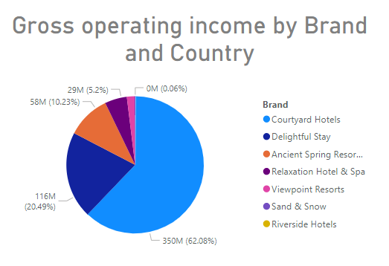
The pie chart shows the percentage of GOI by brand and country. The largest slice of the pie is for the Courtyard brand in the United States, which represents 62% & 350M of the total GOI.
The lowest slice of the pie is for the Viewpoint Resorts brand, which represents 0.06% with 0M of the GOI.
INSIGHTS:
The pie chart shows that the Courtyard brand is the most successful brand in the company, followed by the Delightful Stay brand.
The pie chart also shows that the United States is the most profitable country for the company, followed by the United Kingdom .

Slide 11
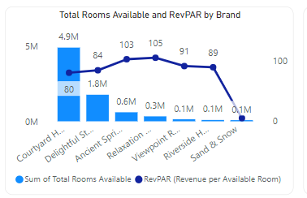
CH has the most rooms available, but it is not generating as much revenue per room as other brands. This suggests that CH may need to focus on increasing its average daily rate or occupancy rate.
DS has the second most rooms available, but it has a higher RevPAR than CH. This suggests that OM is doing a better job of filling its rooms and charging higher rates.
Courtyard H and Delightful St have similar numbers of rooms available, but Courtyard H has a higher RevPAR. This suggests that Courtyard H is doing a better job of generating revenue per room than Delightful St.
Sand & Snow has the lowest number of rooms available, but it has the highest RevPAR. This suggests that Sand & Snow is charging high rates for its rooms and/or is very efficient at filling its rooms.

Slide 12
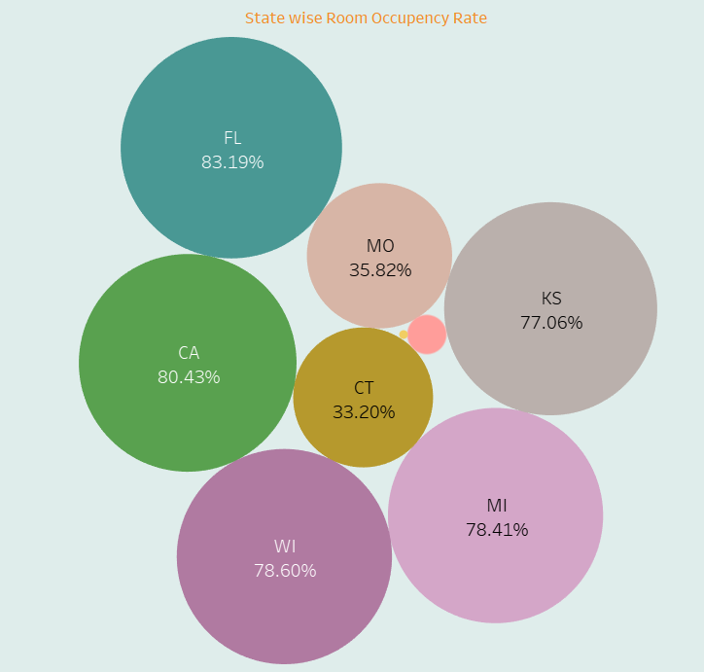
The Bubble chart shows that the state with the highest occupancy rate is Florida, with a rate of 83%. This is followed by California, with a rate of 80%, and WI with a rate of 78%. The states with the lowest occupancy rates are MO with a rate of 35% and CT with a rate of 33%.
INSIGHTS:
Some states are more popular tourist destinations than others, and occupancy rates tend to be higher during the peak tourist season. For example, Florida is a popular destination for winter weather, so its occupancy rate is higher in the winter months.
The occupancy rate can also be affected by the level of competition in the hotel market. For example, if there are a lot of hotels in a particular state, the occupancy rate for each hotel will be lower.

Slide 13
Final Dashboard
Excel, Tableau and Power-BI

Slide 14
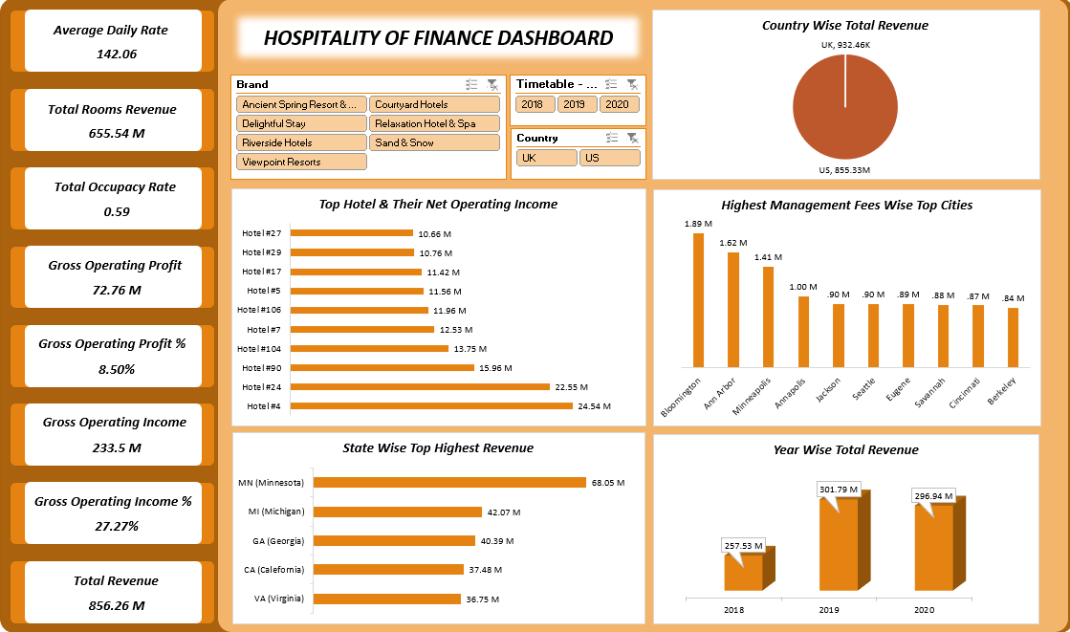
Excel Dashboard

Slide 15
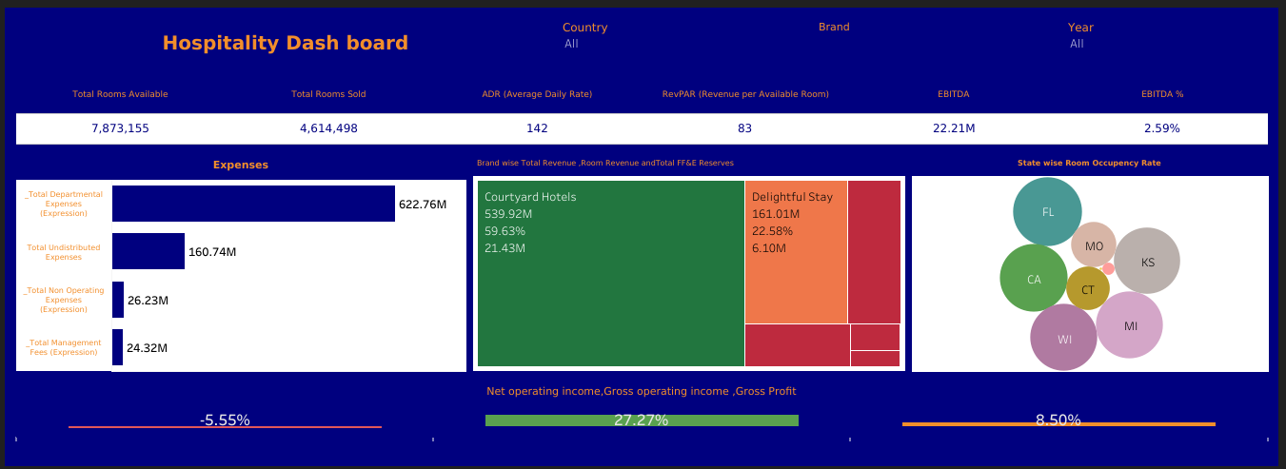
TABLEAU Dashboard

Slide 16
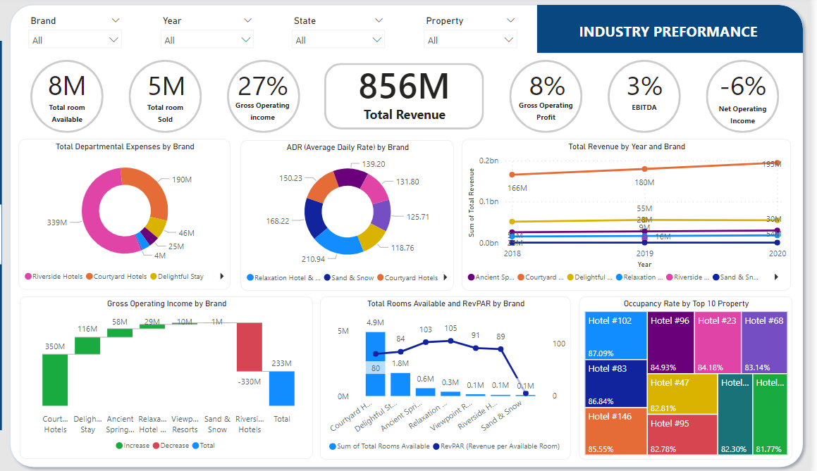
POWER BI Dashboard

Slide 17
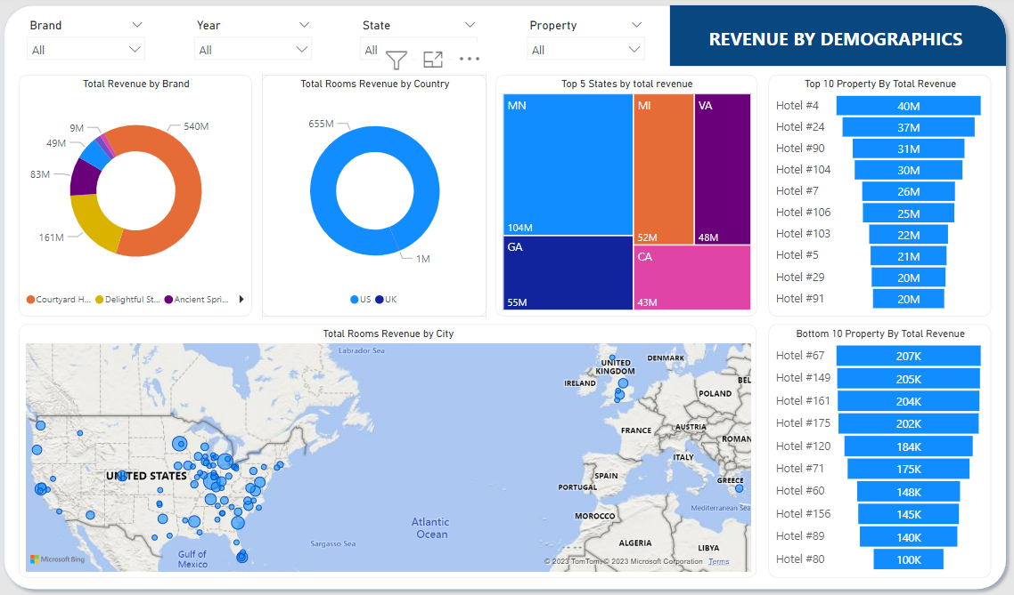

Slide 18
CONCLUSION
Analyzing hospitality finance data provides essential insights for optimizing financial performance, managing costs, maximizing revenue, and making informed strategic decisions. These insights allow the finance team and business leaders to take proactive measures to enhance profitability, drive growth, and ensure the long-term financial sustainability of the hospitality enterprise. The team's dedication and efforts are commendable, and their work stands as a valuable contribution to the world of hospitality finance. Thank you to the entire team for their hard work and dedication to this project.

Slide 19
THANK YOU

